Slide 1
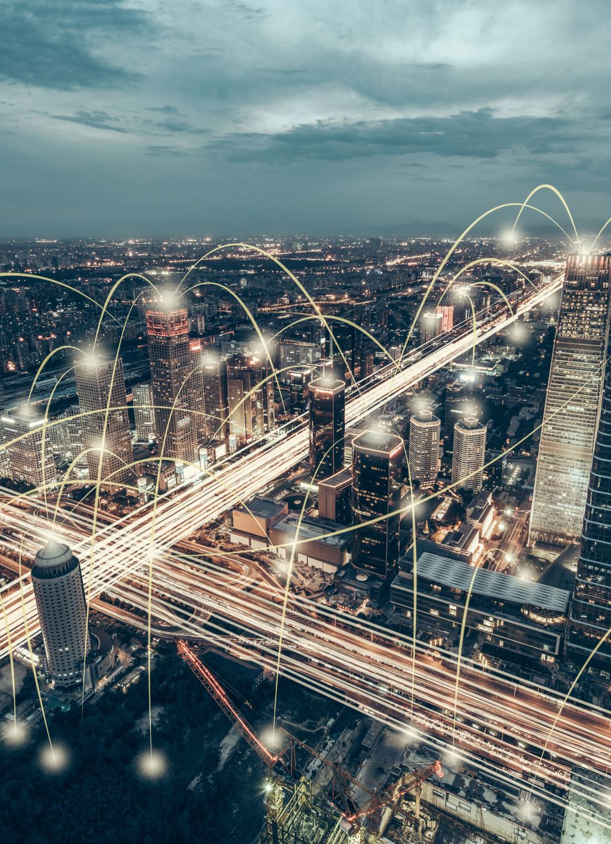
Smart City - Smart Parking Management Using Machine Learning

Slide 2

Subject: -
DS -670 CAPSTONE: BIG DATA & DATA ANALY

Slide 3

Team members: -
Bijnaben Amarabhai Chandera
Jayesh Vala
Thanuboadhi Naveen Reddy

Slide 4
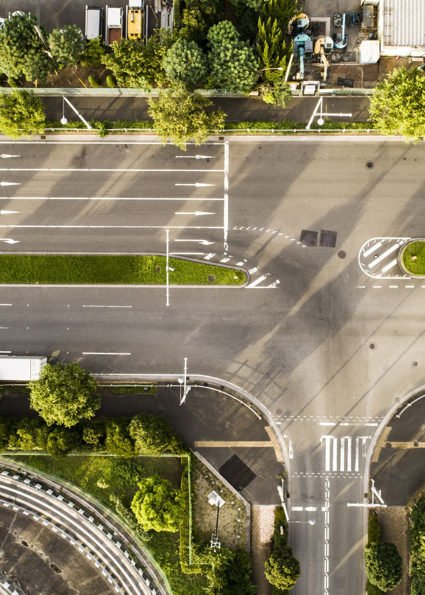
Abstract
As we are in the era of rapid urbanization, smart cities is one of the emerging solution to face the challenges in urban areas
In this project we aim to revolutionize parking in smart cities through machine learning-driven smart parking management
The primary focus of the project is to create a system that not only optimizes parking space usage but also reduces traffic congestion, improves the overall user experience, and lowers carbon emissions

Slide 5
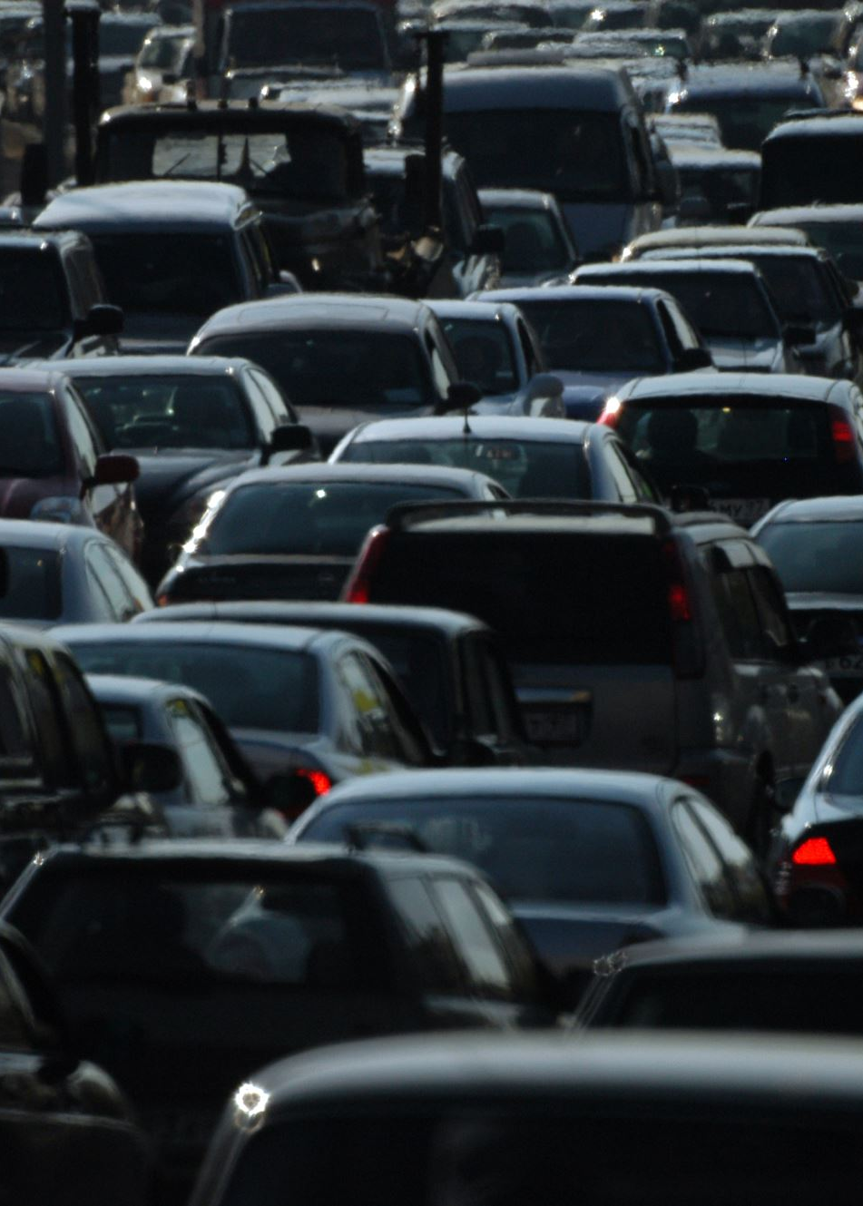
Business Need
In modern cities where there is rapid urbanization there are many challenges such as traffic congestion, environmental pollution, and inefficient use of resources
As there is rapid urbanization the number of vehicles also get increased rapidly, this results in the parking management issues
Finding a parking spot has become a time-consuming and stressful task for drivers, often leading to traffic congestion and increased emissions

Slide 6
Problem Statement
Ineffective parking management is an important factor in traffic jams and pollution in a rapid urbanization cities
The challenge lies in developing a machine learning-driven smart parking solution that optimizes parking space utilization, reduces search time for parking, lowers carbon emissions, and enhances the overall urban living experience

Slide 7








Public Ledger
Parking area
Transaction is updated
if valid
Consensus
Mechanism
System interface service providers
Send transaction for validation
Parking area
Transaction
Interface for integrated
parking services
Parking area
Scanner
Parking
Request/Response
Mobile App
Parking area
User
Architecture of Smart Parking Management

Slide 8

MVP
The Minimum Viable Product (MVP) for the smart parking management system is a streamlined version of the solution that contains the core features necessary to demonstrate the value of machine learning applications within the context of smart city initiatives such as Real-time Parking Availability Detection, Predictive Analytics, Dynamic Pricing Model and User-Friendly App Interface.

Slide 9
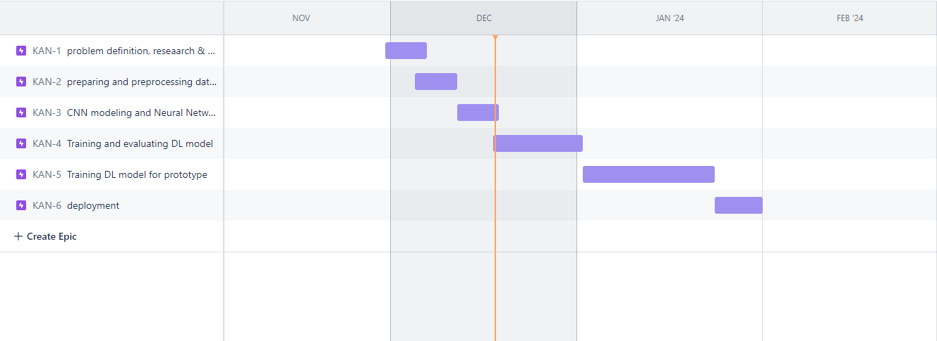
Gantt Chart

Slide 10

REFERENCES
[1] C. Tiexin, T. Miaomiao, and M. Ze, ‘‘The model of parking demand forecast for the urban CCD,’’ Energy Procedia, vol. 16, pp. 1393–1400, 2012.
( https://doi.org/10.1016/j.egypro.2012.01.221)
[2] B. Yang, N. Fantini, and C. S. Jensen, ‘‘iPark,’’ in Proc. 16th Int. Conf. Extending Database Technol. (EDBT), Mar. 2013, pp. 705–708. (https://doi.org/10.1145/2452376.2452459)
[3] X. Chen, ‘‘Parking occupancy prediction and pattern analysis,’’ Dept. Comput. Sci., Stanford Univ., Stanford, CA, USA, Tech. Rep. CS229-2014, 2014.
[4] T. Tiedemann, T. Voegele, M. M. Krell, J. H. Metzen, and F. Kirchner, ‘‘Concept of a data thread-based parking space occupancy prediction in a Berlin pilot region,’’ in Proc. AAAI Workshop, AI Transp., 2015, pp. 1–6.
(https://www.researchgate.net/profile/Mario-Michael-Krell/publication/311734424_Concept_of_a_Data_Thread_Based_Parking_Space_Occupancy_Prediction_in_a_Berlin_Pilot_Region/links/6221872797401151d2faac8f/Concept-of-a-Data-Thread-Based-Parking-Space-Occupancy-Prediction-in-a-Berlin-Pilot-Region.pdf)
[5] Y. Ji, D. Tang, P. Blythe, W. Guo, and W. Wang, ‘‘Short-term forecasting of available parking space using wavelet neural network mode
l,’’ IET Intell. Transp. Syst., vol. 9, no. 2, pp. 202–209, 2015.
( https://doi.org/10.1049/iet-its.2013.0184)

Slide 11
REFERENCES
[6] E. Vlahogianni, K. Kepaptsoglou, V. Tsetsos, and M. Karlaftis, ‘‘A real time parking prediction system for smart cities,’’ J. Intell. Transp. Syst., vol. 20, no. 2, pp. 192–204, 2016.
(https://doi.org/10.1080/15472450.2015.1037955)
[7] M. Caliskan, A. Barthels, B. Scheuermann, and M. Mauve, ‘‘Predicting parking lot occupancy in vehicular ad hoc networks,’’ in Proc. IEEE 65th Veh. Technol. Conf. (VTC7-Spring), Apr. 2007, pp. 277–281.( DOI: 10.1109/VETECS.2007.69)
[8] Z. Yang, H. Liu, and X. Wang, ‘‘The research on the key technologies for improving efficiency of parking guidance system,’’ in Proc. IEEE Int. Conf. Intell. Transp. Syst., Oct. 2003, pp. 1177–1182.( DOI: 10.1109/ITSC.2003.1252670)
[9] D. Teodorović and P. Lučić, ‘‘Intelligent parking systems,’’ Eur. J. Oper. Res., vol. 175, no. 3, pp. 1666–1681, 2006.( https://doi.org/10.1016/j.ejor.2005.02.033)
[10] G. Yan, W. Yang, D. B. Rawat, and S. Olariu, ‘‘SmartParking: A secure and intelligent parking system,’’ IEEE Intell. Transp. Syst. Mag., vol. 3, no. 1, pp. 18–30, Jan. 2011.
(DOI: 10.1109/MITS.2011.940473)

